Slide 1


IBM Applied Data Science Capstone
Reconstructed course-data analysis
27 October 2026
Notes:
Evidence: https://cf-courses-data.s3.us.cloud-object-storage.appdomain.cloud/IBM-DS0321EN-SkillsNetwork/labs/module_5/ds-capstone-template-coursera.pptx
Retrieved 27 October 2026. Analysis reconstructed for this report from public course snapshots. No access to the learner's unshared notebooks.
Official course template artwork retained. No student identity or notebook repository supplied.

Slide 2

Outline
Executive summary and project question
Methodology and data provenance
EDA charts and SQL results
Folium maps and Plotly Dash views
Classification results and conclusions
Appendix: sources and reproducibility
Completed notebooks and Python files:
https://github.com/mohitpingale24-alt/IBM-Stock-Data-Analysis/tree/main/spacex-capstone
Notes:
Evidence: https://cf-courses-data.s3.us.cloud-object-storage.appdomain.cloud/IBM-DS0321EN-SkillsNetwork/datasets/dataset_part_2.csv
Retrieved 27 October 2026. Analysis reconstructed for this report from public course snapshots. No access to the learner's unshared notebooks.

Slide 3
Executive Summary
60 of 90 launches have Class 1 outcomes (66.7%). The course label includes ocean landings.
KSC LC 39A has 17/22 Class 1 outcomes in the EDA snapshot. Site differences also reflect mission mix and time.
The decision tree scores 83.3% on 18 test launches. KNN leads training cross-validation by a small margin.
Historical associations support further analysis, not current launch or price predictions.
Notes:
Evidence: https://cf-courses-data.s3.us.cloud-object-storage.appdomain.cloud/IBM-DS0321EN-SkillsNetwork/datasets/dataset_part_2.csv
Retrieved 27 October 2026. Analysis reconstructed for this report from public course snapshots. No access to the learner's unshared notebooks.

Slide 4
Introduction
Question: Which recorded launch characteristics are associated with Falcon 9 first-stage landing outcomes?
Reusable first stages motivate the analysis, but these datasets contain no recovery cost or bid-price target.
We compare launch site, payload, orbit and flight history, then evaluate four classifiers.
Scope: historical course snapshots, with new calculations and reconstructed map/dashboard views.
Notes:
Evidence: https://cf-courses-data.s3.us.cloud-object-storage.appdomain.cloud/IBM-DS0321EN-SkillsNetwork/datasets/dataset_part_2.csv
Retrieved 27 October 2026. Analysis reconstructed for this report from public course snapshots. No access to the learner's unshared notebooks.

Slide 5

Section 1

Slide 6
Methodology
1 Obtain and validate the published IBM course snapshots
2 Audit missing values, outcome labels and dataset boundaries
3 Execute SQLite queries and explore launch characteristics
4 Rebuild Folium maps and the interactive Dash views
5 Split the modeling data, tune within training folds and evaluate once on a held-out test set
Notes:
Evidence: https://cf-courses-data.s3.us.cloud-object-storage.appdomain.cloud/IBM-DS0321EN-SkillsNetwork/datasets/dataset_part_2.csv
Retrieved 27 October 2026. Analysis reconstructed for this report from public course snapshots. No access to the learner's unshared notebooks.

Slide 7
Data Collection
Source | Records | Use in this report
dataset_part_1 / part_2 | 90 each | Wrangling, EDA and ML
Spacex.csv | 101 | SQL tasks
spacex_launch_geo.csv | 56 | Folium mapping
spacex_launch_dash.csv | 56 | Dash interactions
Keep snapshots separate. Different row counts and labels prevent direct pooling.
Notes:
Evidence: https://cf-courses-data.s3.us.cloud-object-storage.appdomain.cloud/IBM-DS0321EN-SkillsNetwork/datasets/dataset_part_1.csv
https://cf-courses-data.s3.us.cloud-object-storage.appdomain.cloud/IBM-DS0321EN-SkillsNetwork/datasets/dataset_part_2.csv
https://cf-courses-data.s3.us.cloud-object-storage.appdomain.cloud/IBM-DS0321EN-SkillsNetwork/labs/module_2/data/Spacex.csv
https://cf-courses-data.s3.us.cloud-object-storage.appdomain.cloud/IBM-DS0321EN-SkillsNetwork/datasets/spacex_launch_geo.csv
https://cf-courses-data.s3.us.cloud-object-storage.appdomain.cloud/IBM-DS0321EN-SkillsNetwork/datasets/spacex_launch_dash.csv
Retrieved 27 October 2026. Analysis reconstructed for this report from public course snapshots. No access to the learner's unshared notebooks.

Slide 8
Data Collection – SpaceX API
Reconstructed API workflow
Resolve nested identifiers to obtain rocket, launchpad, payload and core attributes. Keep Falcon 9 launches and flatten the fields.
Results here use IBM’s published 90-row CSV. A fresh API harvest was not performed.
GET past launches
Resolve linked resource IDs
Filter Falcon 9 and flatten
Validate and export CSV
Notes:
Evidence: https://github.com/r-spacex/SpaceX-API
Retrieved 27 October 2026. Analysis reconstructed for this report from public course snapshots. No access to the learner's unshared notebooks.

Slide 9
Data Collection – Web Scraping
Data Collection – Web Scraping
Reconstructed scraping workflow
Extract date, booster, site, payload, customer and outcomes. Normalize mass units and remove footnote markers.
Results here use the course SQL snapshot. An independent Wikipedia scrape is now included in the repository. It does not replace the modeling snapshot.
Request launch-list HTML
Parse launch tables
Clean and validate fields
Export a separate CSV
Notes:
Evidence: https://en.wikipedia.org/wiki/List_of_Falcon_9_and_Falcon_Heavy_launches
Retrieved 27 October 2026. Analysis reconstructed for this report from public course snapshots. No access to the learner's unshared notebooks.

Slide 10
Data Wrangling
Audit: 90 unique flight numbers, dated 4 June 2010 to 5 November 2020.
The published payload column already contains imputed values. LandingPad has 26 missing entries and is excluded from modeling.
Class 1 = True ASDS, True RTLS or True Ocean. Class 0 combines failure, unknown and no-landing outcomes.
Exclude Outcome from predictors. Fit numeric scaling and categorical encoding inside training folds.
Notes:
Evidence: https://cf-courses-data.s3.us.cloud-object-storage.appdomain.cloud/IBM-DS0321EN-SkillsNetwork/datasets/dataset_part_2.csv
Retrieved 27 October 2026. Analysis reconstructed for this report from public course snapshots. No access to the learner's unshared notebooks.

Slide 11
EDA with Data Visualization
Flight number versus site and orbit: inspect changes across the launch sequence.
Payload versus site and orbit: compare mission profiles and outcome overlap.
Orbit success bars: compare Class 1 proportions with group sizes.
Yearly success line: inspect historical change. No 2011 observation exists in this snapshot.
All six charts use the same 90-row dataset.
Notes:
Evidence: https://cf-courses-data.s3.us.cloud-object-storage.appdomain.cloud/IBM-DS0321EN-SkillsNetwork/datasets/dataset_part_2.csv
Retrieved 27 October 2026. Analysis reconstructed for this report from public course snapshots. No access to the learner's unshared notebooks.

Slide 12
EDA with SQL
Executed ten SQLite queries on 101 course records.
DISTINCT and LIKE identify launch sites and CCA records.
SUM and AVG summarize payload mass.
MIN identifies the first recorded successful ground landing.
Filters identify drone-ship landings and 2015 failures.
GROUP BY counts mission and landing outcomes.
A MAX subquery returns all tied maximum-payload boosters.
Normalize trailing spaces when interpreting mission outcomes.
Notes:
Evidence: https://cf-courses-data.s3.us.cloud-object-storage.appdomain.cloud/IBM-DS0321EN-SkillsNetwork/labs/module_2/data/Spacex.csv
Retrieved 27 October 2026. Analysis reconstructed for this report from public course snapshots. No access to the learner's unshared notebooks.

Slide 13
Build an Interactive Map with Folium
Circle markers identify the four site labels in the course file.
A marker cluster contains all 56 launch outcomes. Green means Class 1 and red means Class 0.
Mouse coordinates help inspect the area. Lines show straight-line distances to selected proximity points.
The proximity example uses approximate sample points, not surveyed nearest-feature distances. Course coordinates also require validation before operational use.
Notes:
Evidence: https://cf-courses-data.s3.us.cloud-object-storage.appdomain.cloud/IBM-DS0321EN-SkillsNetwork/datasets/spacex_launch_geo.csv
Retrieved 27 October 2026. Analysis reconstructed for this report from public course snapshots. No access to the learner's unshared notebooks.

Slide 14
Build a Dashboard with Plotly Dash
The site selector switches between all launches and one site.
For all sites, the pie shows each site’s share of successful outcomes. For one site, it shows the Class 0 / Class 1 ratio.
The payload slider filters the scatter plot. Booster version supplies the color grouping.
Screenshots show a locally reconstructed Dash application using the official 56-row course file.
Notes:
Evidence: https://cf-courses-data.s3.us.cloud-object-storage.appdomain.cloud/IBM-DS0321EN-SkillsNetwork/datasets/spacex_launch_dash.csv
Retrieved 27 October 2026. Analysis reconstructed for this report from public course snapshots. No access to the learner's unshared notebooks.

Slide 15
Predictive Analysis (Classification)
Stratified 80/20 split, seed 42: 72 training and 18 test launches.
Five-fold stratified cross-validation tunes logistic regression, SVM, decision tree and KNN on training data only.
Numeric pipeline: median imputation and standard scaling. Categorical pipeline: one-hot encoding with unseen categories ignored.
Choose by mean validation accuracy. Report test accuracy and a confusion matrix without retuning on the test set.
Notes:
Evidence: https://cf-courses-data.s3.us.cloud-object-storage.appdomain.cloud/IBM-DS0321EN-SkillsNetwork/datasets/dataset_part_2.csv
Retrieved 27 October 2026. Analysis reconstructed for this report from public course snapshots. No access to the learner's unshared notebooks.

Slide 16
Results
EDA: 66.7% Class 1 overall, with substantial variation across orbit and launch year.
SQL: NASA (CRS) payload totals 45,596 kg. The first recorded ground-pad success is 22 December 2015.
Dash: KSC LC-39A contributes 10 of 24 successful outcomes and has the highest site ratio, 10/13.
ML: validation-selected KNN scores 14/18 on the test set. The decision tree scores 15/18.
Notes:
Evidence: https://cf-courses-data.s3.us.cloud-object-storage.appdomain.cloud/IBM-DS0321EN-SkillsNetwork/datasets/dataset_part_2.csv
Retrieved 27 October 2026. Analysis reconstructed for this report from public course snapshots. No access to the learner's unshared notebooks.

Slide 17

Section 2

Slide 18
Flight Number vs. Launch Site
Later flights contain more Class 1 outcomes.
Site rates: CCAFS 60.0%, KSC 77.3%, VAFB 76.9%.
1 CCAFS SLC 40
2 KSC LC 39A
3 VAFB SLC 4E
IBM EDA snapshot: 90 launches. Class 1 includes five successful ocean outcomes.
Notes:
Evidence: https://cf-courses-data.s3.us.cloud-object-storage.appdomain.cloud/IBM-DS0321EN-SkillsNetwork/datasets/dataset_part_2.csv
Retrieved 27 October 2026. Analysis reconstructed for this report from public course snapshots. No access to the learner's unshared notebooks.

Slide 19
Payload vs. Launch Site
Payload ranges overlap across sites.
Payload alone does not separate Class 0 and Class 1. Site comparisons also reflect orbit and launch year.
1 CCAFS SLC 40
2 KSC LC 39A
3 VAFB SLC 4E
IBM EDA snapshot: 90 launches. Class 1 includes five successful ocean outcomes.
Notes:
Evidence: https://cf-courses-data.s3.us.cloud-object-storage.appdomain.cloud/IBM-DS0321EN-SkillsNetwork/datasets/dataset_part_2.csv
Retrieved 27 October 2026. Analysis reconstructed for this report from public course snapshots. No access to the learner's unshared notebooks.

Slide 20
Success Rate vs. Orbit Type
GTO: 14/27 (51.9%).
VLEO: 12/14 (85.7%).
ES-L1, GEO and HEO each contain one launch.
SSO: 5/5 (100%).
Descriptive rates. Small groups cannot establish an orbit advantage.
Notes:
Evidence: https://cf-courses-data.s3.us.cloud-object-storage.appdomain.cloud/IBM-DS0321EN-SkillsNetwork/datasets/dataset_part_2.csv
Retrieved 27 October 2026. Analysis reconstructed for this report from public course snapshots. No access to the learner's unshared notebooks.

Slide 21
Flight Number vs. Orbit Type
Orbit mix changes over the launch sequence. VLEO appears late in this snapshot.
1 ES-L1
2 GEO
3 GTO
4 HEO
5 ISS
6 LEO
7 MEO
8 PO
9 SO
10 SSO
11 VLEO
IBM EDA snapshot: 90 launches. Class 1 includes five successful ocean outcomes.
Notes:
Evidence: https://cf-courses-data.s3.us.cloud-object-storage.appdomain.cloud/IBM-DS0321EN-SkillsNetwork/datasets/dataset_part_2.csv
Retrieved 27 October 2026. Analysis reconstructed for this report from public course snapshots. No access to the learner's unshared notebooks.

Slide 22
Payload vs. Orbit Type
Heavy VLEO launches often succeed. This association is not causal.
1 ES-L1
2 GEO
3 GTO
4 HEO
5 ISS
6 LEO
7 MEO
8 PO
9 SO
10 SSO
11 VLEO
IBM EDA snapshot: 90 launches. Class 1 includes five successful ocean outcomes.
Notes:
Evidence: https://cf-courses-data.s3.us.cloud-object-storage.appdomain.cloud/IBM-DS0321EN-SkillsNetwork/datasets/dataset_part_2.csv
Retrieved 27 October 2026. Analysis reconstructed for this report from public course snapshots. No access to the learner's unshared notebooks.

Slide 23
Launch Success Yearly Trend
2017: 15/18 (83.3%)
2018: 11/18 (61.1%)
2019: 9/10 (90.0%)
2020: 16/19 (84.2%)
The trend improves over the early years but is not monotonic.
2011 has no records. 2020 ends on 5 November and is not a full-year census.
Notes:
Evidence: https://cf-courses-data.s3.us.cloud-object-storage.appdomain.cloud/IBM-DS0321EN-SkillsNetwork/datasets/dataset_part_2.csv
Retrieved 27 October 2026. Analysis reconstructed for this report from public course snapshots. No access to the learner's unshared notebooks.

Slide 24
All Launch Site Names
Four labels appear. CCAFS LC-40 and SLC-40 refer to the same pad designation across records.
Launch_Site
CCAFS LC-40
CCAFS SLC-40
KSC LC-39A
VAFB SLC-4E
SELECT DISTINCT Launch_Site
FROM launches ORDER BY Launch_Site
Notes:
Evidence: https://cf-courses-data.s3.us.cloud-object-storage.appdomain.cloud/IBM-DS0321EN-SkillsNetwork/labs/module_2/data/Spacex.csv
Retrieved 27 October 2026. Analysis reconstructed for this report from public course snapshots. No access to the learner's unshared notebooks.
SELECT DISTINCT Launch_Site FROM launches ORDER BY Launch_Site

Slide 25
Launch Site Names Begin with 'CCA'
First five matches in date order, with a deterministic ORDER BY.
Date | Booster_Version | Launch_Site
2010-06-04 | F9 v1.0 B0003 | CCAFS LC-40
2010-12-08 | F9 v1.0 B0004 | CCAFS LC-40
2012-05-22 | F9 v1.0 B0005 | CCAFS LC-40
2012-10-08 | F9 v1.0 B0006 | CCAFS LC-40
2013-03-01 | F9 v1.0 B0007 | CCAFS LC-40
SELECT Date,Booster_Version,Launch_Site
FROM launches
WHERE Launch_Site LIKE 'CCA%' ORDER BY Date LIMIT 5
Notes:
Evidence: https://cf-courses-data.s3.us.cloud-object-storage.appdomain.cloud/IBM-DS0321EN-SkillsNetwork/labs/module_2/data/Spacex.csv
Retrieved 27 October 2026. Analysis reconstructed for this report from public course snapshots. No access to the learner's unshared notebooks.
SELECT Date,Booster_Version,Launch_Site FROM launches WHERE Launch_Site LIKE 'CCA%' ORDER BY Date LIMIT 5

Slide 26
Total Payload Mass: NASA (CRS)
Exact customer match: NASA (CRS). This total excludes other NASA customer labels.
kg
45596
SELECT SUM(PAYLOAD_MASS__KG_) AS kg
FROM launches
WHERE Customer='NASA (CRS)'
Notes:
Evidence: https://cf-courses-data.s3.us.cloud-object-storage.appdomain.cloud/IBM-DS0321EN-SkillsNetwork/labs/module_2/data/Spacex.csv
Retrieved 27 October 2026. Analysis reconstructed for this report from public course snapshots. No access to the learner's unshared notebooks.
SELECT SUM(PAYLOAD_MASS__KG_) AS kg FROM launches WHERE Customer='NASA (CRS)'

Slide 27
Average Payload Mass: F9 v1.1
Prefix match includes all F9 v1.1 booster identifiers.
kg
2534.67
SELECT AVG(PAYLOAD_MASS__KG_) AS kg
FROM launches
WHERE Booster_Version LIKE 'F9 v1.1%'
Notes:
Evidence: https://cf-courses-data.s3.us.cloud-object-storage.appdomain.cloud/IBM-DS0321EN-SkillsNetwork/labs/module_2/data/Spacex.csv
Retrieved 27 October 2026. Analysis reconstructed for this report from public course snapshots. No access to the learner's unshared notebooks.
SELECT AVG(PAYLOAD_MASS__KG_) AS kg FROM launches WHERE Booster_Version LIKE 'F9 v1.1%'

Slide 28
First Successful Ground Landing
Minimum date where Landing_Outcome is exactly Success (ground pad).
Date
2015-12-22
SELECT MIN(Date) AS Date
FROM launches
WHERE Landing_Outcome='Success (ground pad)'
Notes:
Evidence: https://cf-courses-data.s3.us.cloud-object-storage.appdomain.cloud/IBM-DS0321EN-SkillsNetwork/labs/module_2/data/Spacex.csv
Retrieved 27 October 2026. Analysis reconstructed for this report from public course snapshots. No access to the learner's unshared notebooks.
SELECT MIN(Date) AS Date FROM launches WHERE Landing_Outcome='Success (ground pad)'

Slide 29
Drone-Ship Successes: 4,000–6,000 kg
Strict inequalities exclude payloads equal to 4,000 or 6,000 kg.
Booster_Version
F9 FT B1022
F9 FT B1026
F9 FT B1021.2
F9 FT B1031.2
SELECT DISTINCT Booster_Version
FROM launches
WHERE Landing_Outcome='Success (drone ship)' AND PAYLOAD_MASS__KG_ > 4000 AND PAYLOAD_MASS__KG_ < 6000
Notes:
Evidence: https://cf-courses-data.s3.us.cloud-object-storage.appdomain.cloud/IBM-DS0321EN-SkillsNetwork/labs/module_2/data/Spacex.csv
Retrieved 27 October 2026. Analysis reconstructed for this report from public course snapshots. No access to the learner's unshared notebooks.
SELECT DISTINCT Booster_Version FROM launches WHERE Landing_Outcome='Success (drone ship)' AND PAYLOAD_MASS__KG_ > 4000 AND PAYLOAD_MASS__KG_ < 6000

Slide 30
Mission Outcomes
After trimming spaces: 99 Success, 1 payload-status-unclear success, 1 in-flight failure.
Mission_Outcome | n
Failure (in flight) | 1
Success | 99
Success (payload status unclear) | 1
SELECT TRIM(Mission_Outcome) AS Mission_Outcome, COUNT(*) AS n
FROM launches GROUP BY TRIM(Mission_Outcome)
Notes:
Evidence: https://cf-courses-data.s3.us.cloud-object-storage.appdomain.cloud/IBM-DS0321EN-SkillsNetwork/labs/module_2/data/Spacex.csv
Retrieved 27 October 2026. Analysis reconstructed for this report from public course snapshots. No access to the learner's unshared notebooks.
SELECT TRIM(Mission_Outcome) AS Mission_Outcome, COUNT(*) AS n FROM launches GROUP BY TRIM(Mission_Outcome)

Slide 31
Boosters with Maximum Payload
All 12 tied records carry 15,600 kg. No arbitrary single winner.
Booster version | Booster version | Payload (kg)
F9 B5 B1048.4 | F9 B5 B1049.5 | 15,600
F9 B5 B1049.4 | F9 B5 B1060.2 | 15,600
F9 B5 B1051.3 | F9 B5 B1058.3 | 15,600
F9 B5 B1056.4 | F9 B5 B1051.6 | 15,600
F9 B5 B1048.5 | F9 B5 B1060.3 | 15,600
F9 B5 B1051.4 | F9 B5 B1049.7 | 15,600
SELECT Booster_Version,PAYLOAD_MASS__KG_
FROM launches
WHERE PAYLOAD_MASS__KG_=(SELECT MAX(PAYLOAD_MASS__KG_)
FROM launches)
Notes:
Evidence: https://cf-courses-data.s3.us.cloud-object-storage.appdomain.cloud/IBM-DS0321EN-SkillsNetwork/labs/module_2/data/Spacex.csv
Retrieved 27 October 2026. Analysis reconstructed for this report from public course snapshots. No access to the learner's unshared notebooks.
SELECT Booster_Version,PAYLOAD_MASS__KG_ FROM launches WHERE PAYLOAD_MASS__KG_=(SELECT MAX(PAYLOAD_MASS__KG_) FROM launches)

Slide 32
2015 Drone-Ship Landing Failures
Two failures match the exact drone-ship label. Other failure categories are excluded.
Date | Booster_Version | Launch_Site
2015-01-10 | F9 v1.1 B1012 | CCAFS LC-40
2015-04-14 | F9 v1.1 B1015 | CCAFS LC-40
SELECT Date,Booster_Version,Launch_Site
FROM launches
WHERE Date LIKE '2015%' AND Landing_Outcome='Failure (drone ship)'
Notes:
Evidence: https://cf-courses-data.s3.us.cloud-object-storage.appdomain.cloud/IBM-DS0321EN-SkillsNetwork/labs/module_2/data/Spacex.csv
Retrieved 27 October 2026. Analysis reconstructed for this report from public course snapshots. No access to the learner's unshared notebooks.
SELECT Date,Booster_Version,Launch_Site FROM launches WHERE Date LIKE '2015%' AND Landing_Outcome='Failure (drone ship)'

Slide 33
Landing Outcomes: 2010–2017
Inclusive date range: 4 June 2010 through 20 March 2017. 31 records in total.
Landing_Outcome | n
No attempt | 10
Success (drone ship) | 5
Failure (drone ship) | 5
Success (ground pad) | 3
Controlled (ocean) | 3
Uncontrolled (ocean) | 2
Failure (parachute) | 2
Precluded (drone ship) | 1
SELECT Landing_Outcome,COUNT(*) AS n
FROM launches
WHERE Date BETWEEN '2010-06-04' AND '2017-03-20' GROUP BY Landing_Outcome ORDER BY n DESC
Notes:
Evidence: https://cf-courses-data.s3.us.cloud-object-storage.appdomain.cloud/IBM-DS0321EN-SkillsNetwork/labs/module_2/data/Spacex.csv
Retrieved 27 October 2026. Analysis reconstructed for this report from public course snapshots. No access to the learner's unshared notebooks.
SELECT Landing_Outcome,COUNT(*) AS n FROM launches WHERE Date BETWEEN '2010-06-04' AND '2017-03-20' GROUP BY Landing_Outcome ORDER BY n DESC

Slide 34

Section 3

Slide 35
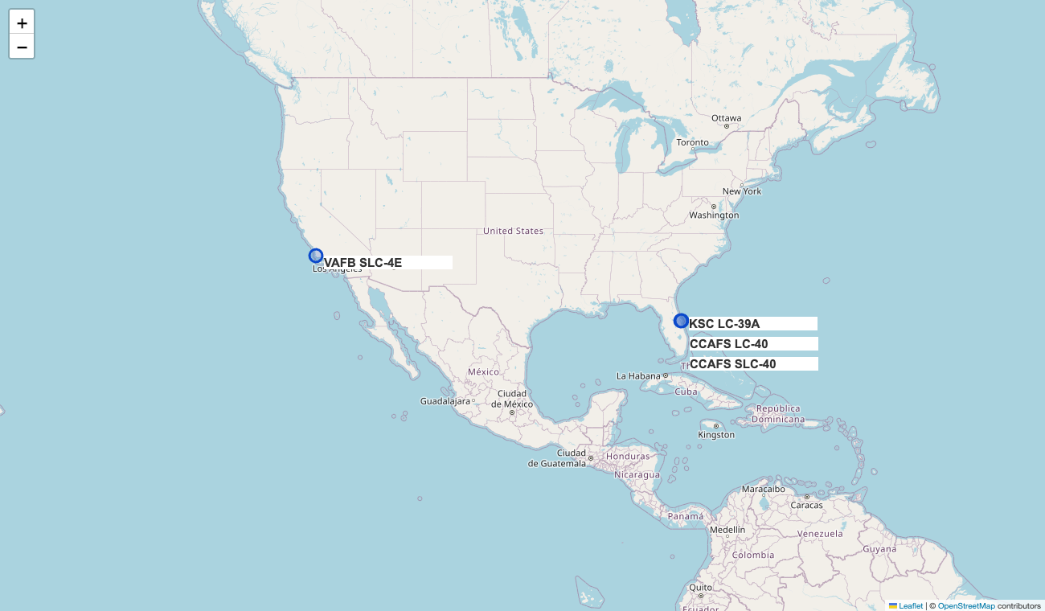
Launch Sites in the Course Snapshot
Four site labels span Florida and California.
The two CCAFS labels nearly overlap. Keep raw labels visible when auditing the source.
Reconstructed Folium view. Basemap: OpenStreetMap contributors. Source: IBM geographic snapshot.
Notes:
Evidence: https://cf-courses-data.s3.us.cloud-object-storage.appdomain.cloud/IBM-DS0321EN-SkillsNetwork/datasets/spacex_launch_geo.csv
Retrieved 27 October 2026. Analysis reconstructed for this report from public course snapshots. No access to the learner's unshared notebooks.
Course coordinates retained as provided, including the approximate KSC point.

Slide 36
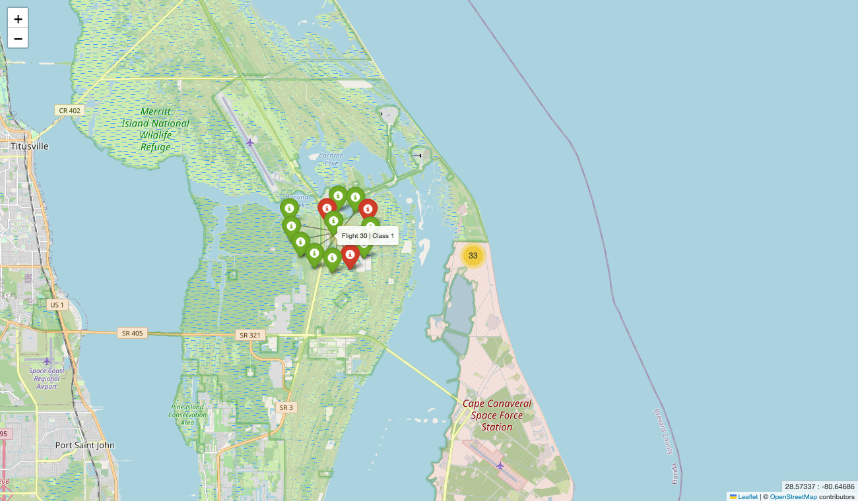
Launch Outcomes at Cape Canaveral
The Folium cluster holds all 56 records.
Expand a cluster to inspect green Class 1 and red Class 0 markers at the same coordinates.
Reconstructed Folium view. Basemap: OpenStreetMap contributors. Source: IBM geographic snapshot.
Notes:
Evidence: https://cf-courses-data.s3.us.cloud-object-storage.appdomain.cloud/IBM-DS0321EN-SkillsNetwork/datasets/spacex_launch_geo.csv
Retrieved 27 October 2026. Analysis reconstructed for this report from public course snapshots. No access to the learner's unshared notebooks.
Course coordinates retained as provided, including the approximate KSC point.

Slide 37
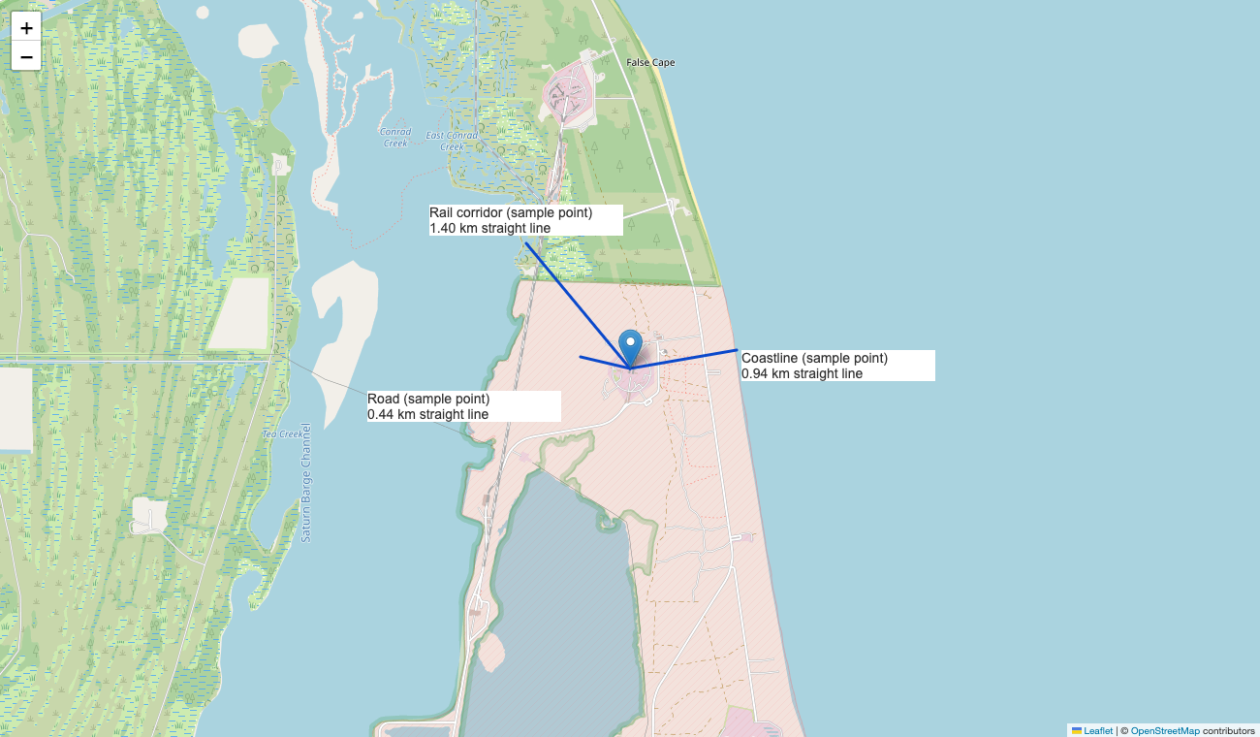
CCAFS LC-40 Proximity Example
Selected points:
Coastline: 0.94 km
Road: 0.44 km
Rail corridor: 1.40 km
Approximate sample points. Distances are straight line, not nearest-feature measurements.
Reconstructed Folium view. Basemap: OpenStreetMap contributors. Source: IBM geographic snapshot.
Notes:
Evidence: https://cf-courses-data.s3.us.cloud-object-storage.appdomain.cloud/IBM-DS0321EN-SkillsNetwork/datasets/spacex_launch_geo.csv
Retrieved 27 October 2026. Analysis reconstructed for this report from public course snapshots. No access to the learner's unshared notebooks.
Haversine radius 6371 km. Pad (28.562302,-80.577356). Sample coastline (28.5637,-80.5679), road (28.5632,-80.5817), rail corridor (28.5720,-80.5865). No claim these are verified nearest features.

Slide 38

Section 4

Slide 39
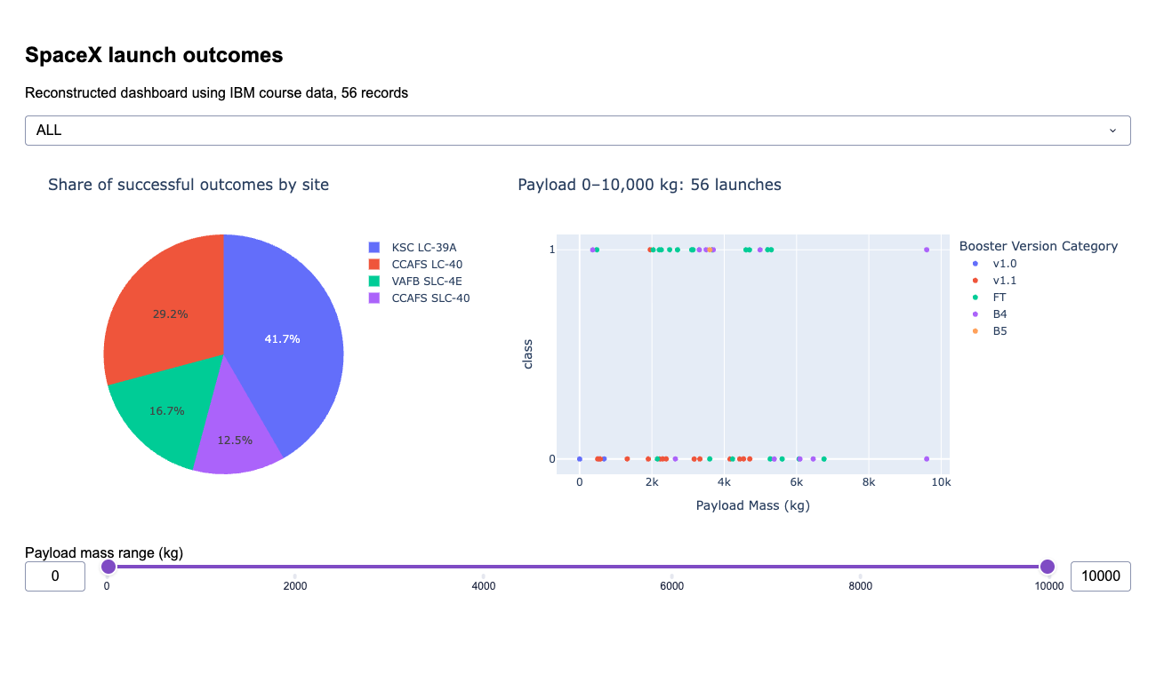
Dashboard: Successful Outcomes by Site
KSC: 10 of 24 successes (41.7%).
This pie compares success counts across sites. It does not show each site’s success probability.
Reconstructed, functioning Plotly Dash application. IBM dashboard snapshot: 56 launches.
Notes:
Evidence: https://cf-courses-data.s3.us.cloud-object-storage.appdomain.cloud/IBM-DS0321EN-SkillsNetwork/datasets/spacex_launch_dash.csv
Retrieved 27 October 2026. Analysis reconstructed for this report from public course snapshots. No access to the learner's unshared notebooks.

Slide 40
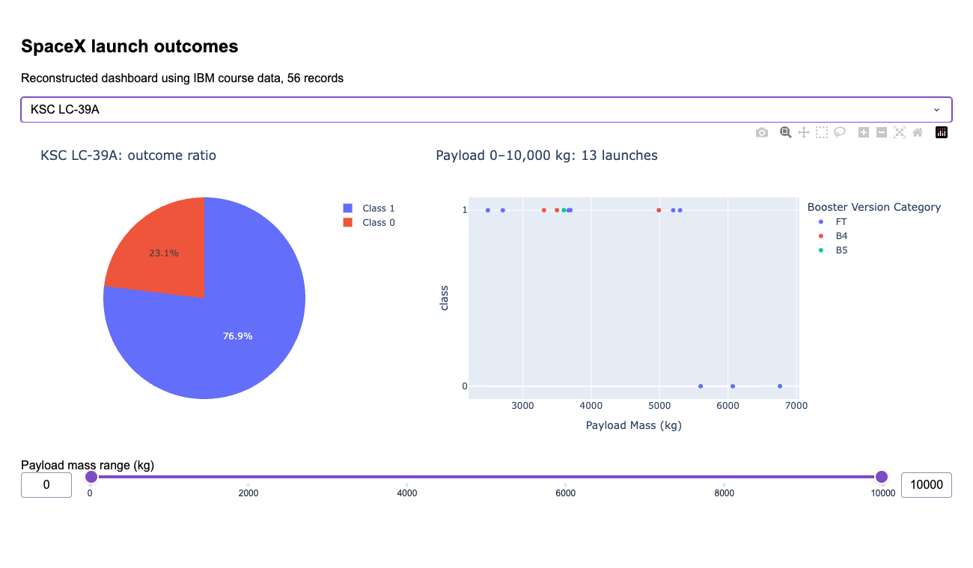
Dashboard: KSC LC-39A Outcome Ratio
KSC has the highest site ratio in this snapshot:
10 Class 1 / 13 launches = 76.9%.
The sample contains only 13 launches.
Reconstructed, functioning Plotly Dash application. IBM dashboard snapshot: 56 launches.
Notes:
Evidence: https://cf-courses-data.s3.us.cloud-object-storage.appdomain.cloud/IBM-DS0321EN-SkillsNetwork/datasets/spacex_launch_dash.csv
Retrieved 27 October 2026. Analysis reconstructed for this report from public course snapshots. No access to the learner's unshared notebooks.

Slide 41
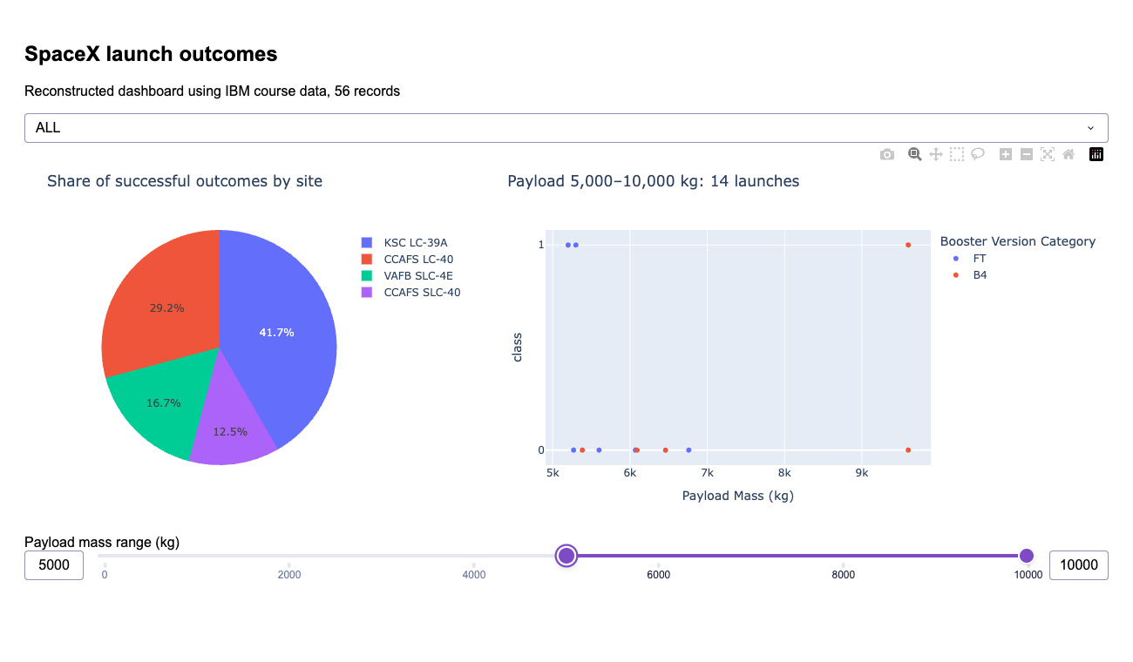
Dashboard: Payload Range Filter
The 5,000–10,000 kg range contains 14 launches and 5 Class 1 outcomes (35.7%).
Compare this selected range with the full range on slide 39.
B5 has 1/1 success overall. That single launch cannot establish version superiority.
Reconstructed, functioning Plotly Dash application. IBM dashboard snapshot: 56 launches.
Notes:
Evidence: https://cf-courses-data.s3.us.cloud-object-storage.appdomain.cloud/IBM-DS0321EN-SkillsNetwork/datasets/spacex_launch_dash.csv
Retrieved 27 October 2026. Analysis reconstructed for this report from public course snapshots. No access to the learner's unshared notebooks.

Slide 42

Section 5

Slide 43
Classification Accuracy
Tree has the highest observed test score: 15/18.
KNN leads CV: 89.0%, versus SVM 88.9%.
Always-Class-1 test baseline: 12/18 (66.7%).
Model selection uses training CV. Test-set ranking is descriptive and must not guide retuning.
Notes:
Evidence: https://cf-courses-data.s3.us.cloud-object-storage.appdomain.cloud/IBM-DS0321EN-SkillsNetwork/datasets/dataset_part_2.csv
Retrieved 27 October 2026. Analysis reconstructed for this report from public course snapshots. No access to the learner's unshared notebooks.
[{"name":"Logistic regression","cv":0.8485714285714285,"cvstd":0.06348888880951988,"test":0.7777777777777778,"precision":0.75,"recall":1,"f1":0.8571428571428571,"cm":[[2,4],[0,12]],"params":{"model__C":0.1}},{"name":"SVM","cv":0.8885714285714286,"cvstd":0.06904597699196899,"test":0.7777777777777778,"precision":0.75,"recall":1,"f1":0.8571428571428571,"cm":[[2,4],[0,12]],"params":{"model__C":1,"model__gamma":"scale","model__kernel":"rbf"}},{"name":"Decision tree","cv":0.8457142857142858,"cvstd":0.0716251263884311,"test":0.8333333333333334,"precision":0.8,"recall":1,"f1":0.8888888888888888,"cm":[[3,3],[0,12]],"params":{"model__criterion":"gini","model__max_depth":3,"model__min_samples_leaf":4}},{"name":"KNN","cv":0.8895238095238096,"cvstd":0.09022018920220987,"test":0.7777777777777778,"precision":0.7857142857142857,"recall":0.9166666666666666,"f1":0.8461538461538461,"cm":[[3,3],[1,11]],"params":{"model__n_neighbors":3,"model__p":1,"model__weights":"distance"}}]

Slide 44
Confusion Matrices
Decision tree | Predicted 0 | Predicted 1
Actual 0 | 3 | 3
Actual 1 | 0 | 12
KNN (CV selected) | Predicted 0 | Predicted 1
Actual 0 | 3 | 3
Actual 1 | 1 | 11
Decision tree: accuracy 83.3%, precision 80.0%, recall 100%, F1 88.9%.
KNN: accuracy 77.8%, precision 78.6%, recall 91.7%, F1 84.6%.
Both falsely predict success for 3 of the 6 actual Class 0 launches.
Notes:
Evidence: https://cf-courses-data.s3.us.cloud-object-storage.appdomain.cloud/IBM-DS0321EN-SkillsNetwork/datasets/dataset_part_2.csv
Retrieved 27 October 2026. Analysis reconstructed for this report from public course snapshots. No access to the learner's unshared notebooks.
Positive class = 1. Matrices use rows actual and columns predicted.

Slide 45
Conclusions
Historical launch outcomes improve across the early flight sequence. Orbit, payload and site remain entangled with time and mission mix.
The course target includes ocean successes and groups unknown outcomes with failures. It does not directly measure booster recovery for reuse.
The tree achieves 83.3% test accuracy, but the test set has only 18 launches. KNN and SVM are effectively tied in CV.
Next steps: validate prelaunch feature availability, use time-based testing, refine the recovery target and quantify uncertainty.
Notes:
Evidence: https://cf-courses-data.s3.us.cloud-object-storage.appdomain.cloud/IBM-DS0321EN-SkillsNetwork/datasets/dataset_part_2.csv
Retrieved 27 October 2026. Analysis reconstructed for this report from public course snapshots. No access to the learner's unshared notebooks.

Slide 46
Appendix: Reproducibility
EDA / ML: 90 rows, 60 Class 1 and 30 Class 0. Train/test split: 72/18, stratified, random_state=42.
Predictors: FlightNumber, PayloadMass, Flights, Block, ReusedCount, Orbit, LaunchSite, GridFins, Reused and Legs.
Exclude Outcome, Class, LandingPad, Serial, Date and redundant location fields from X. ReusedCount needs a prelaunch-availability audit.
Five CV folds, shuffled with seed 42. scikit-learn 1.9.1. Executed notebooks and Python files are available in the linked repository.
Completed notebooks and Python files:
https://github.com/mohitpingale24-alt/IBM-Stock-Data-Analysis/tree/main/spacex-capstone
Notes:
Evidence: https://cf-courses-data.s3.us.cloud-object-storage.appdomain.cloud/IBM-DS0321EN-SkillsNetwork/datasets/dataset_part_2.csv
Retrieved 27 October 2026. Analysis reconstructed for this report from public course snapshots. No access to the learner's unshared notebooks.

Slide 47
Appendix: Hyperparameter Search
Model | Grid | Selected
Logistic | C: .01, .1, 1, 10, 100 | C=.1
SVM | C: .1, 1, 10, 100 kernel: linear/rbf; gamma: scale/.01/.1 | C=1, rbf, gamma=scale
Tree | depth: 2,3,4,5,None; leaf: 1,2,4 criterion: gini/entropy | depth=3, leaf=4, gini
KNN | neighbors: 3,5,7,9; p: 1,2 weights: uniform/distance | k=3, p=1, distance
Best mean CV accuracy selects each configuration. No test data enter preprocessing or tuning.
47
Notes:
Evidence: https://cf-courses-data.s3.us.cloud-object-storage.appdomain.cloud/IBM-DS0321EN-SkillsNetwork/datasets/dataset_part_2.csv
Retrieved 27 October 2026. Analysis reconstructed for this report from public course snapshots. No access to the learner's unshared notebooks.

Slide 48
Appendix: Evidence and Limitations
Completed here: CSV audits, ten SQLite queries, six EDA charts, four trained classifiers, Folium maps and working Dash views.
API: official IBM snapshot, with an optional live collector. Web scraping: executed independently on archived Wikipedia HTML. Modeling results continue to use the IBM snapshot.
Maps preserve course coordinates. Proximity points are approximate demonstrations. No surveyed distance or site-safety claim follows.
Random splitting can share booster history across sets. Prior payload imputation and possible retrospective fields limit leakage guarantees.
48
Notes:
Evidence: https://cf-courses-data.s3.us.cloud-object-storage.appdomain.cloud/IBM-DS0321EN-SkillsNetwork/datasets/dataset_part_2.csv
https://cf-courses-data.s3.us.cloud-object-storage.appdomain.cloud/IBM-DS0321EN-SkillsNetwork/datasets/spacex_launch_geo.csv
Retrieved 27 October 2026. Analysis reconstructed for this report from public course snapshots. No access to the learner's unshared notebooks.

Slide 49
Appendix: Sources
IBM course data and template (retrieved 27 October 2026)
https://cf-courses-data.s3.us.cloud-object-storage.appdomain.cloud/IBM-DS0321EN-SkillsNetwork/
EDA / ML: datasets/dataset_part_1.csv and dataset_part_2.csv
SQL: labs/module_2/data/Spacex.csv
Maps: datasets/spacex_launch_geo.csv
Dashboard: datasets/spacex_launch_dash.csv
Template: labs/module_5/ds-capstone-template-coursera.pptx
API methodology: github.com/r-spacex/SpaceX-API
Scraping methodology: Wikipedia, List of Falcon 9 and Falcon Heavy launches
Basemap attribution: OpenStreetMap contributors
Completed notebooks and Python files:
https://github.com/mohitpingale24-alt/IBM-Stock-Data-Analysis/tree/main/spacex-capstone
49
Notes:
Evidence: https://cf-courses-data.s3.us.cloud-object-storage.appdomain.cloud/IBM-DS0321EN-SkillsNetwork/datasets/dataset_part_2.csv
https://cf-courses-data.s3.us.cloud-object-storage.appdomain.cloud/IBM-DS0321EN-SkillsNetwork/datasets/dataset_part_1.csv
https://cf-courses-data.s3.us.cloud-object-storage.appdomain.cloud/IBM-DS0321EN-SkillsNetwork/labs/module_2/data/Spacex.csv
https://cf-courses-data.s3.us.cloud-object-storage.appdomain.cloud/IBM-DS0321EN-SkillsNetwork/datasets/spacex_launch_geo.csv
https://cf-courses-data.s3.us.cloud-object-storage.appdomain.cloud/IBM-DS0321EN-SkillsNetwork/datasets/spacex_launch_dash.csv
https://cf-courses-data.s3.us.cloud-object-storage.appdomain.cloud/IBM-DS0321EN-SkillsNetwork/labs/module_5/ds-capstone-template-coursera.pptx
https://github.com/r-spacex/SpaceX-API
https://en.wikipedia.org/wiki/List_of_Falcon_9_and_Falcon_Heavy_launches
Retrieved 27 October 2026. Analysis reconstructed for this report from public course snapshots. No access to the learner's unshared notebooks.

Slide 50

SpaceX Falcon 9 historical analysis

